Slide 1


Crime Insurance

Slide 2

Objectives
Understand Commercial Crime Insurance
Study the crime related loss exposures arising out of business
Understand the insuring agreements under commercial crime policy
Study the commercial crime limits and deductibles
Study the exclusions under the policy

Slide 3
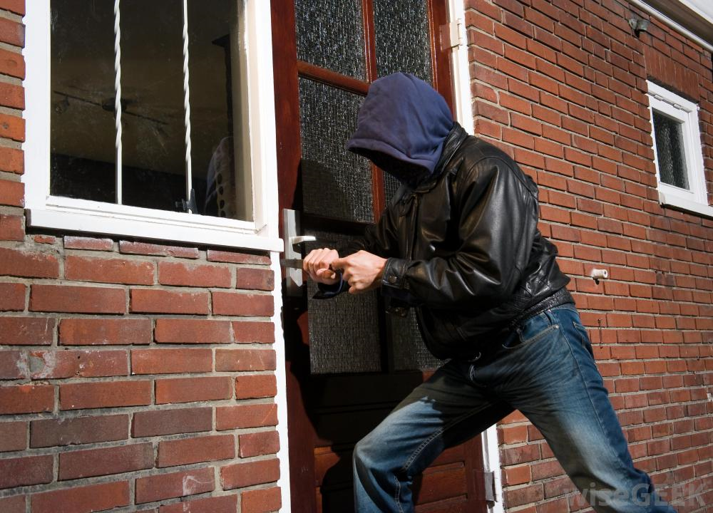
Crime Insurance
Insurance that provides coverage against crime by employees or external entities to protect businesses against financial Loss. It includes the following:
Money and securities against numerous perils
Property other than money and securities against crime perils such as employee theft, robbery, theft by outsiders and extortion
An organization’s property is exposure to numerous crime related loss exposures:
Robbery
Burglary
Forgery
Credit card fraud
Computer fraud
It is issued in two forms:
Discovery Form: Covers losses discovered during policy period even though they may have occurred before the policy period
Loss Sustained Form: Covers losses actually sustained during the policy period and discovered no later than one year after policy expiration

Slide 4
Crime Insurance - Insuring Agreements
The insuring agreements include:
Employee theft - “Theft” of “money”, “securities” and “other property” committed by an “employee” in the territory of US or temporarily outside for 90 days “Forgery” by an employee is also covered
Forgery or alteration - “Forgery” and alteration of checks, drafts etc. drawn by the insured or his agent anywhere in the world. Forgery by an employee is excluded
Inside the premises – Theft of money and securities: “Theft”, disappearance or destruction of money & securities, damage to the premises, damage or loss to locked safe, vaults because of the thief’s presence inside the premises
Inside the premises – Robbery or Safe burglary of other property - Loss due to actual or attempted “robbery” of a “custodian” to other tangible property inside the premises, damages to the locked safe, vaults inside the premises and also the damage to the premises

Slide 5
Insuring Agreements contd…
Outside the premises - “Theft”, disappearance & destruction of “money” and “securities” and actual or attempted “robbery” of “other property” outside the premises under the custody of a messenger or an armored car inside the territories of the US
Computer and funds transfer fraud - Usage of computer to fraudulently cause a transfer of “money”, “securities” and “other property” and fraudulent instruction directing the financial institution to debit “money” and “securities” from the insured’s account anywhere in the world
Money orders and counterfeit money - Acceptance of money orders, counterfeit money under good-faith within the territory of the US

Slide 6

Crime Insurance – Limits and Deductible
Limits
Separate limits may apply for each insuring agreement. If a loss is covered in more than one insuring agreement, the insurer will pay no more than the highest limit of the insuring agreements that apply
An “occurrence” includes an individual act, the combined total of all separate acts or a series of acts
Payment is made per occurrence basis
Special limits of insurance is provided for :
Precious metals, stone, pearls furs
Manuscripts, drawings or records
Inside the premises – robbery and safe burglary of other property - $ 5,000 per occurrence for 1 and 2
Outside the premises - $ 5,000 per occurrence for 1 and 2
Computer and funds transfer fraud coverage - $ 5,000 per occurrence for 2
Deductible
Loss will be paid only for the amount in excess of deductible

Slide 7
Crime Insurance - Exclusions
Exclusions
General Exclusions
Acts committed by you, your partners and members – Excludes theft or dishonest act committed by named insured, his partners or members whether acting in collusion or with other members
Acts committed known to you prior to the policy period – Excludes if the act by the employee was known to named insured his partner/members prior to the policy effective date
Indirect losses – Excludes losses of e.g. business income loss, liability payments, expense to establish the amount of loss
Government action – Excludes loss from the seizure or destruction of property by order of government authority
Nuclear hazard – Excludes losses by nuclear reaction, radiation or radioactive contamination
Pollution – Excludes the discharge, dispersal, seepage, migration, release or escape solid, liquid or gaseous contaminant
War and military action

Slide 8
Exclusions contd…
Employee Theft
Inventory shortages – Excludes loss that depends on inventory or profit-and-loss calculations to prove either the existence or the amount of loss
Trading – Excludes an employee’s unauthorized trading in stocks, bonds etc. from the named insured’s account
Warehouse receipts – Excludes loss resulting from an employee’s fraudulent or dishonest signing or issuing a warehouse receipt
Inside and Outside the Premises
Arithmetic errors and omissions – Excludes loss resulting from arithmetic errors and omissions
Fire – Excludes loss caused by fire despite its cause. Although loss by fire to safe or vault is covered
Motor vehicles or equipment – Excludes loss caused to motor vehicles or equipment which is better covered under BACF
Vandalism – Excludes loss caused by an act of vandalism or malicious mischief
Computer and Funds Transfer Fraud
Authorized access, fraudulent instructions and credit card transactions

Slide 9
ISO Commercial Crime – Sample Documents
Commercial Crime Coverage (Discovery Form)
Commercial Crime Coverage (Loss-Sustained Form)
Commercial Crime Policy – Declarations Page

Slide 10
Thank You

